Slide 1




MOHAMMAD IBRAHIM ALI - 06177 - BS (COMPUTER SCIENCE)
PocketList
TASK MANAGEMENT APPLICATION
PRESENTED TO:
DR. AYAZ UL HASSAN KHAN
COURSE:
DATA STRUCTURES & ALGORITHMS

Slide 2



POCKETLIST: TASK MANAGEMENT APPLICATION
INTRODUCTION
Introducing the software, the objectives considered while creating the application and how were they achieved.
Table of Contents
CODE PREMIERE
Showing a real running of code and how different parts of codes work for different features in the application.
CODE ANALYSIS
The algorithms implemented in the code for implication of different features, their complexity and time durations.
REFERENCES
A list of references used in the creation of the application and a window for questions.

Slide 3



POCKETLIST: TASK MANAGEMENT APPLICATION
Introduction
Starter Idea
Objectives
Libraries
Algorithms

Slide 4



POCKETLIST: TASK MANAGEMENT APPLICATION
Starter Idea
Basic Thought
This project is aimed to create a task management software that could help in an efficient planning of tasks, reminders and idea generation.
Duration
The tentative duration for this project will be 2 months,which will cover code fragmentation, debugging, application of GUI and finalization.
Structure
This project will be executed by the use of different data structures that include but not limit to; queues(priority queue, circular queue), stacks, dictionaries and lists. It will also involve different sorting and searching algorithms that we worked upon, in the course.

Slide 5
POCKETLIST: TASK MANAGEMENT APPLICATION
Starter Idea
Learning Outcome
The project would make me able to work upon the algorithms in solving some real world problems, and to learn how different techniques can help execute the problem faster.
Goal
the project overall tends to make this system, a very simple, faster, easy-to-use and interactive, as much as possible.

Slide 6
POCKETLIST: TASK MANAGEMENT APPLICATION
Objectives
Correct Implementation
Given a problem, correctly choose and implement suitable data structures (such as stacks/queues, graphs, tree) to solve that problem.
Analysis
The tentative duration for this project will be 2 months,which will cover code fragmentation, debugging, application of GUI and finalization.
Structure
This project will be executed by the use of different data structures that include but not limit to; queues(priority queue, circular queue), stacks, dictionaries and lists. It will also involve different sorting and searching algorithms that we worked upon, in the course.

Slide 7
POCKETLIST: TASK MANAGEMENT APPLICATION
Objectives
Basic Functionalities
Making the user able to organize tasks by adding them, prioritizing them, marking them as done or deleting them.
User is able to search for a task. through filters, so that he/she may get to the extra details.

Slide 8
POCKETLIST: TASK MANAGEMENT APPLICATION
Objectives
Extra Functionalities
Tracking time for each tasks and keeping a queue of user's progress in executing his/her tasks.
Adding features like reminder and a dashboard showing all tasks at one place

Slide 9
POCKETLIST: TASK MANAGEMENT APPLICATION
Libraries
Back-end Coding
openpyxl
datetime
time
Front-end Coding
tkinter
win10toast

Slide 10
POCKETLIST: TASK MANAGEMENT APPLICATION
Algorithms
Search Functions
Binary Search Algorithm
Sort Functions
Quick Sort Algorithm

Slide 11




POCKETLIST: TASK MANAGEMENT APPLICATION
Code
Premiere

Slide 12


POCKETLIST: TASK MANAGEMENT APPLICATION
Code
Analysis
Add Task
Remove Task
Sort Task
by Name
by Starting Date
by Deadline
Target Hour
Urgency

Slide 13

POCKETLIST: TASK MANAGEMENT APPLICATION
Add Task
Basic Code: List Append Function

Slide 14

POCKETLIST: TASK MANAGEMENT APPLICATION
Add Task
Complexity
Adding an element to a list would be considered one operation.
Once the function runs, it performs the operation only one time.
Hence, the big-O time complexity for this function would be:
O(1)

Slide 15
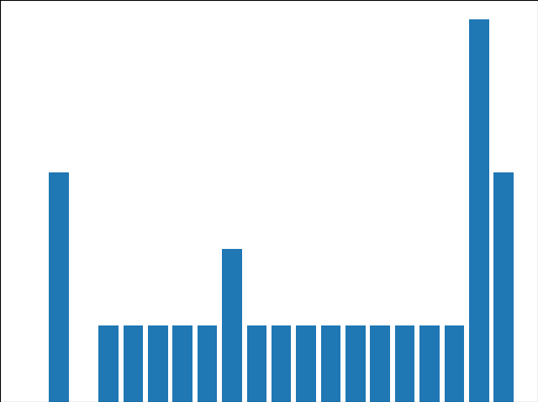
POCKETLIST: TASK MANAGEMENT APPLICATION
Add Task
Performance Graph
The performance graph of the function in terms of the time consumed, for adding 20 elements in the list is given beside.

Slide 16
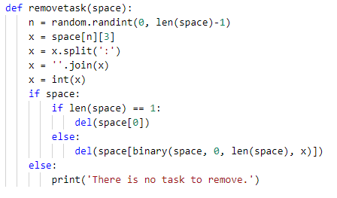
POCKETLIST: TASK MANAGEMENT APPLICATION
Remove Task
Basic Code: If-else Checkpoint

Slide 17
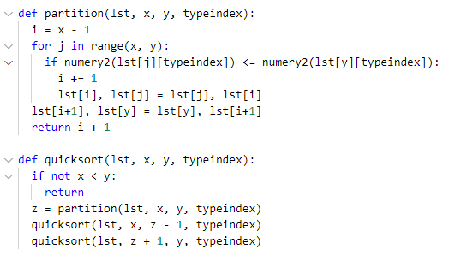
POCKETLIST: TASK MANAGEMENT APPLICATION
Remove Task
Basic Code: Quick-sort Algorithm

Slide 18
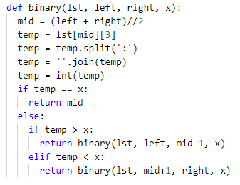
POCKETLIST: TASK MANAGEMENT APPLICATION
Remove Task
Basic Code: Binary Search Algorithm

Slide 19
POCKETLIST: TASK MANAGEMENT APPLICATION
Remove Task
Complexity
The if-else checkpoint in the function have all operations that run only one time, once the part of the function is called. Hence, the complexity of the if-else checkpoint is
O(1)
The Quick-sort Algorithjm , in the worst case, will make partitions of the list by taking the first or the last element as the pivot. In that case, the number of operations would double the number of elements in the list, while getting on each element. hence, the complexity of the quick-sort algorithm would be,
O(n^2)
The Binary Search Algorithm, in the worst case, will use the divide-and-conquer appraoch. It would repeatedly halve the list, and will choose one of those two halves, In repetitive bisection, the number of operations performed would be a function of logarithm, Hence, the complexity of the binary-search alogirthm would be,
O(log n)

Slide 20

POCKETLIST: TASK MANAGEMENT APPLICATION
Remove Task
Performance Graph
The performance graph of the function in terms of the time consumed, for removing 10 elements in the list is given beside.

Slide 21
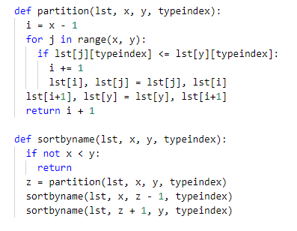
POCKETLIST: TASK MANAGEMENT APPLICATION
Sort Task (by Name)
Basic Code: Quick-sort Algorithm

Slide 22
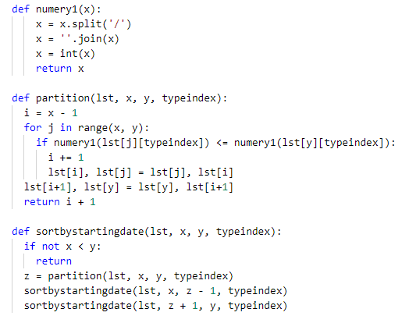
POCKETLIST: TASK MANAGEMENT APPLICATION
Sort Task (by Starting Date)
Basic Code: Quick-sort Algorithm

Slide 23
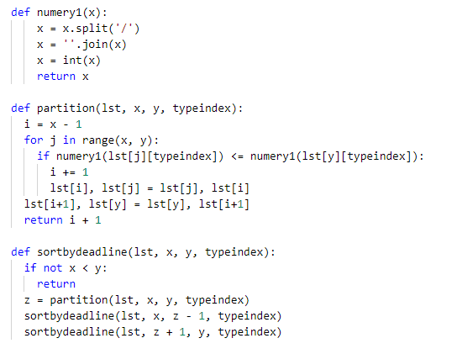
POCKETLIST: TASK MANAGEMENT APPLICATION
Sort Task (by Deadline)
Basic Code: Quick-sort Algorithm

Slide 24
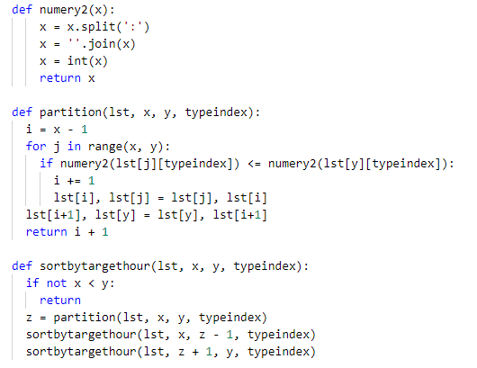
POCKETLIST: TASK MANAGEMENT APPLICATION
Sort Task (by Target Hour)
Basic Code: Quick-sort Algorithm

Slide 25
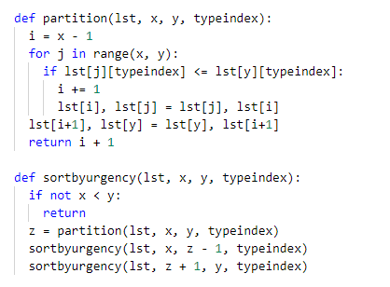
POCKETLIST: TASK MANAGEMENT APPLICATION
Sort Task (by Urgency)
Basic Code: Quick-sort Algorithm

Slide 26
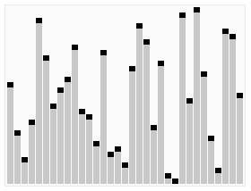
POCKETLIST: TASK MANAGEMENT APPLICATION
Sort Task
Complexity
The Quick-sort Algorithm, though more efficient than other complex sorting algorithms, can take a bit more time than usual, if the pivot selection isn't favorable. A visual representation of how quick-sort works is shown below.

Slide 27
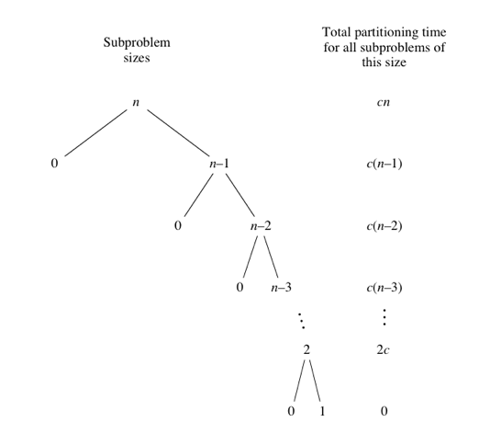
POCKETLIST: TASK MANAGEMENT APPLICATION
Sort Task
Complexity
In the worst case, the selection of pivot that divides the list into two partitions with elements greater than and lesser than the pivot respectively, would be either the first element or the last element. This would infact, generate the tree given here.

Slide 28
POCKETLIST: TASK MANAGEMENT APPLICATION
Sort Task
Complexity
If we make a sequence of number of operations (sorting operation) performed at each iteration, we would get the following sequence. Adding the elements through the sum of series formula would derive the following. We need to subtract 1 from it, since 1 isn't included in the sequence of operations
cn+c(n−1)+c(n−2)+⋯+2c ​ = c(n+(n−1)+(n−2)+⋯+2)
= c((n+1)(n/2)−1) .​
In big-Θ notation, quicksort's worst-case running time is O(n^2)

Slide 29
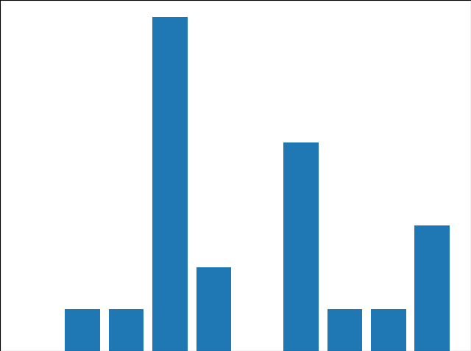
POCKETLIST: TASK MANAGEMENT APPLICATION
Sort Task (by Name)
Performance Graph
The performance graph of the function in terms of the time consumed, for shuffling the list and then sorting it by the task name for 10 iterations.

Slide 30

POCKETLIST: TASK MANAGEMENT APPLICATION
Sort Task (by Starting Date)
Performance Graph
The performance graph of the function in terms of the time consumed, for shuffling the list and then sorting it by the starting date for 10 iterations.

Slide 31

POCKETLIST: TASK MANAGEMENT APPLICATION
Sort Task (by Deadline)
Performance Graph
The performance graph of the function in terms of the time consumed, for shuffling the list and then sorting it by the deadline for 10 iterations.

Slide 32

POCKETLIST: TASK MANAGEMENT APPLICATION
Sort Task (by Target Hour)
Performance Graph
The performance graph of the function in terms of the time consumed, for shuffling the list and then sorting it by the target hour for 10 iterations.

Slide 33

POCKETLIST: TASK MANAGEMENT APPLICATION
POCKETLIST: TASK MANAGEMENT APPLICATION
Sort Task (by Urgency)
Performance Graph
The performance graph of the function in terms of the time consumed, for shuffling the list and then sorting it by the urgency for 10 iterations.

Slide 34

POCKETLIST: TASK MANAGEMENT APPLICATION
References
Code
Documentation

Slide 35
POCKETLIST: TASK MANAGEMENT APPLICATION
References - Code
https://www.geeksforgeeks.org/python-simple-registration-form-using-tkinter/
https://www.geeksforgeeks.org/python-tkinter-text-widget/
https://python-forum.io/Thread-Tkinter-Tkinter-Font-Color
https://docs.python.org/3/library/tkinter.ttk.html
http://effbot.org/tkinterbook/listbox.html#:~:text=The%20Listbox%20widget%20is%20a,more%20alternatives%20from%20the%20list.
https://subscription.packtpub.com/book/web_development/9781788622301/1/ch01lvl1sec19/displaying-a-list-of-items
https://www.geeksforgeeks.org/python-binding-function-in-tkinter/
https://https://pythonexamples.org/python-tkinter-set-window-size/
https://effbot.org/tkinterbook/place.htm
datatofish.com/entry-box-tkinter/
https://www.geeksforgeeks.org/python-place-method-in-tkinter/
https://yagisanatode.com/2018/02/23/how-do-i-change-the-size-and-position-of-the-main-window-in-tkinter-and-python-3/
https://effbot.org/tkinterbook/button.htm
https://www.geeksforgeeks.org/python-gui-tkinter/
Lectures from the course 'Data Structures & Algorithm Overflow: Various coding glitches were sorted out through this.

Slide 36
POCKETLIST: TASK MANAGEMENT APPLICATION
References - Documentation
https://stackoverflow.com/questions/58792963/time-complexity-for-adding-elements-to-list-vs-set-in-python#:~:text=The%20time%20complexity%20for%20appending,array%20that%20the%20data%20is
https://en.wikipedia.org/wiki/Quicksort#/media/File:Sorting_quicksort_anim.gif
https://www.khanacademy.org/computing/computer-science/algorithms/quick-sort/a/analysis-of-quicksor
https://www.khanacademy.org/computing/computer-science/algorithms/binary-search/a/running-time-of-binary-search

Slide 37

NEW HIRE RESOURCES
Got questions?
Thank you !

